Slide 1
ARDS and Displays

Slide 2
ADaM -> Display
Pros
Cons
Simple process
One program per display
Multiple people can work independently on each display
Same sorts of analysis may be redone and implemented for every display
QC not only Values, but formatting
Rounding
Spaces
Alignment
QCing plots?

Slide 3
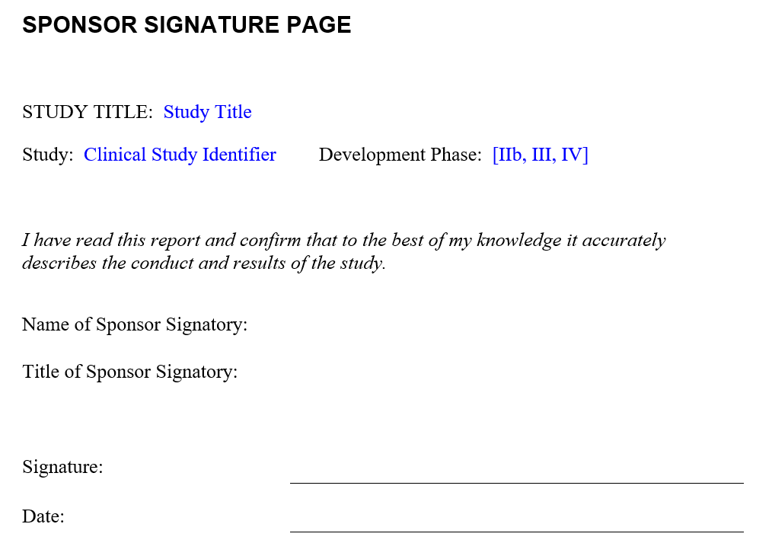
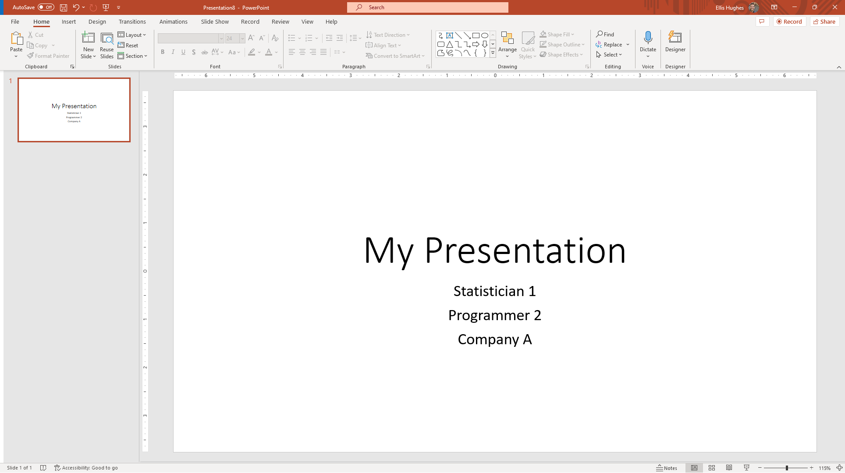
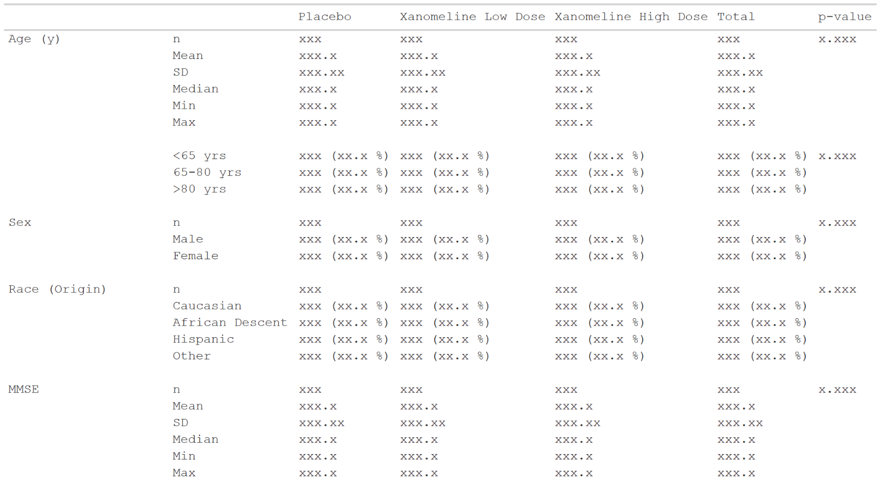

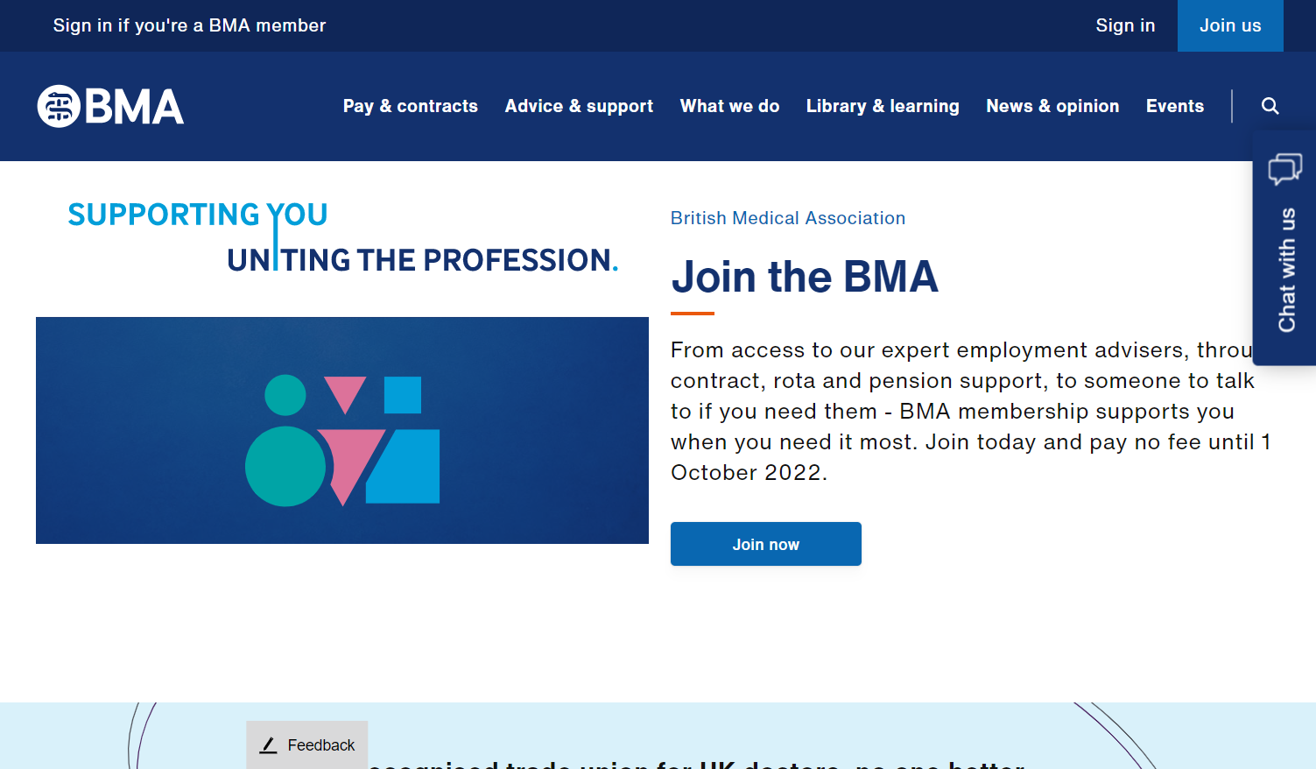

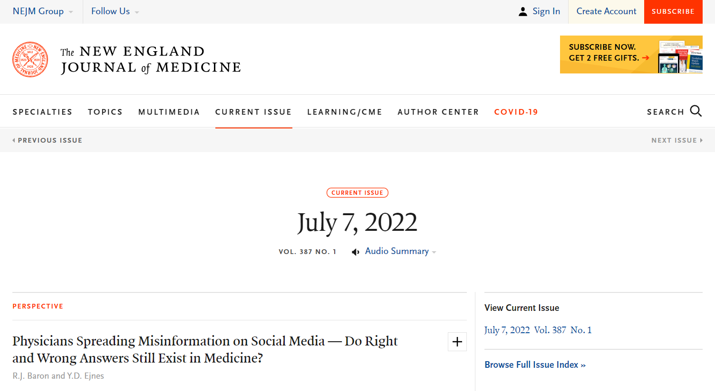
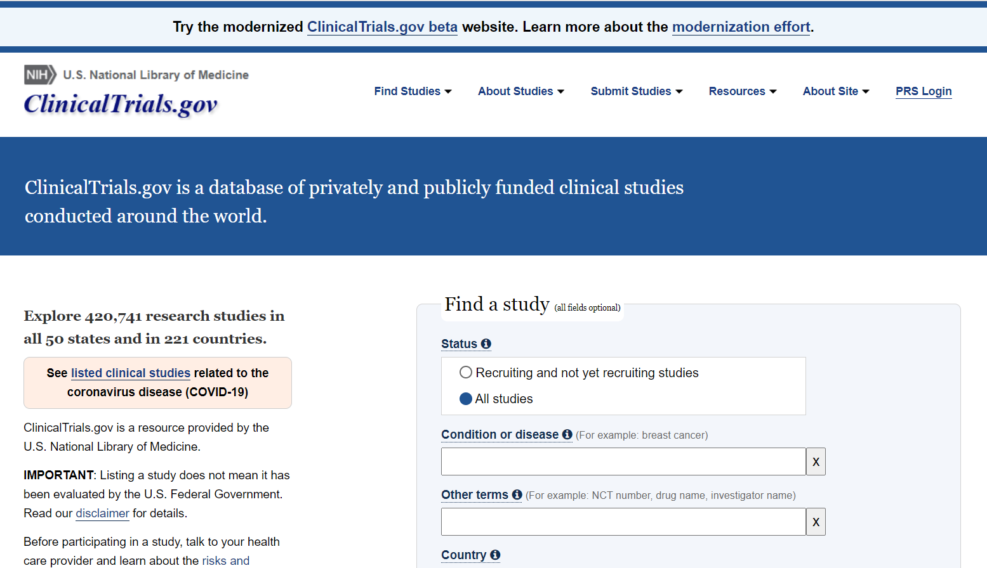
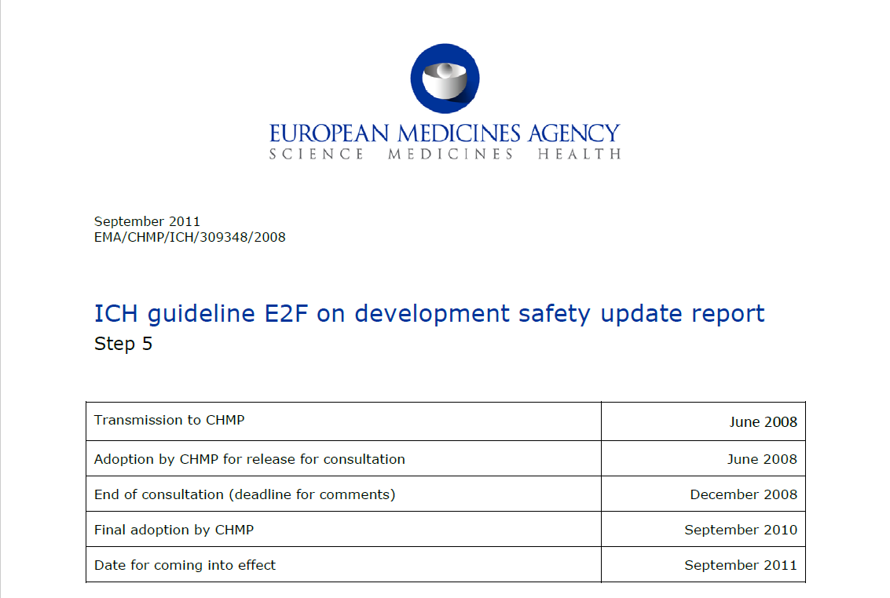
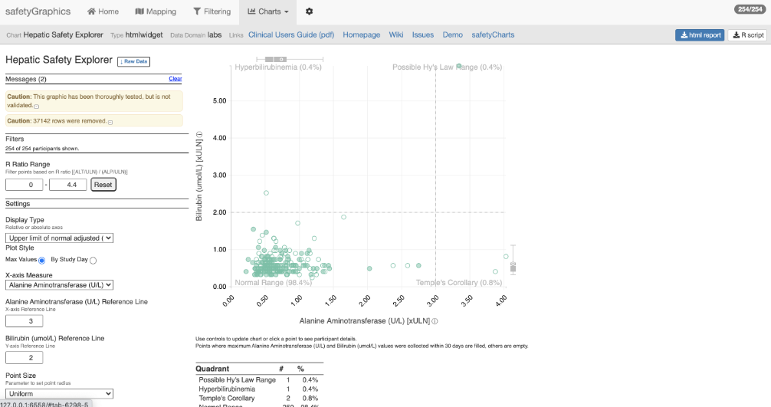
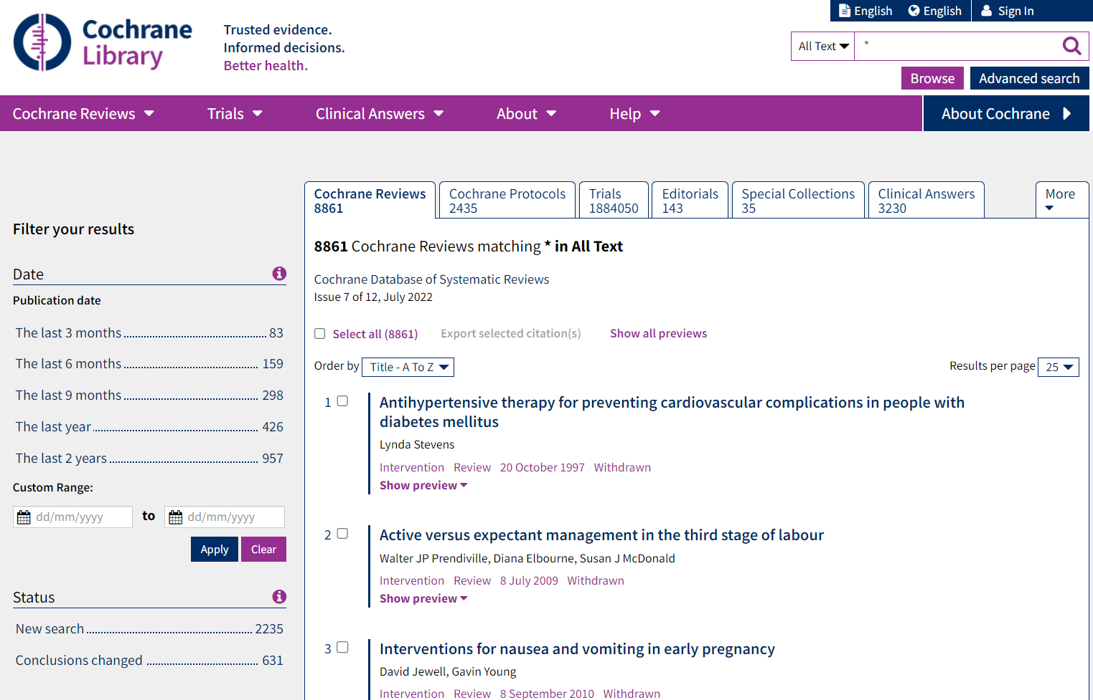
Analysis Results Data
The Possibilities
In-text CSR
Presentations
Submissions
Publications
Data Analysis
ADaM
Analysis Results Data
clinicaltrials.gov
Integrated safety reporting
Dynamic apps
Meta-analyses

Slide 4
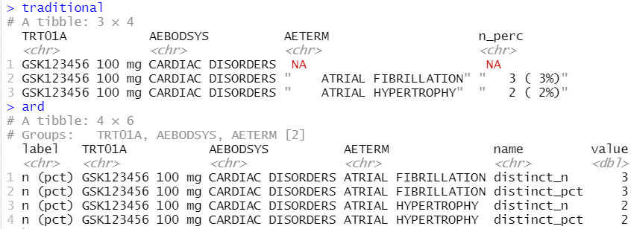
Analysis Results Data
Key features
Unformatted values
1 value per row
Distinct columns for each grouping variable
Include everything you want to display (particularly labels)
Interested in reading more, see:
Why we should respect analysis results as data
Why we should respect analysis results as data
Joana M Barros, Lukas A Widmer, Mark Baillie, Simon Wandel, (Analytics, Novartis Pharma AG, Basel, Switzerland)
https://doi.org/10.48550/arXiv.2204.09959
15 September 2023
4

Slide 5
Creating ARDs
ARD’s are naturally ‘Tidy’
A single row per record
Aligns with tidyverse approaches
Simplest approach is to use tidyverse to generate ARDs
Highly supported ecosystem
Lots of users
Documentation on development strategy, trusted authors, etc

Slide 6
Pharmaverse ARD Packages
Tplyr & ardis
Atorus Research
Tplyr is purpose built to help convert ADaMs into tables
ardis is its successor focusing on ARD generation
cards
New (early stage) package
Insights Engineering
Focusing on helping create CDISC ARDS (where it gets its name)

Slide 7
Great, we have ARD’s, but you said we’d have Displays

Slide 8



Analysis Results Data
The Possibilities
In-text CSR
Presentations
Submissions
Publications
Data Analysis
ADaM
Analysis Results Data
clinicaltrials.gov
Integrated safety reporting
Dynamic apps
Meta-analyses

Slide 9
{tfrmt}
General Purpose:
Building tables from ARDs based on metadata
Lifecycle:
Currently available on CRAN. New functionality is still being added
Common Functions:
tfrmt()
Setup a table
body_plan()
Defines the body of the table
frmt_structure()
Defines which rows to apply formatting to
frmt_combine()/frmt_when()/frmt()
Defines the formatting
col_plan()
Sets column appearance
row_grp_plan()
Defines the style for each group
print_mock_gt()
Prints to gt without data to produce a mock
print_to_gt()
Prints to gt with data to make final table
https://gsk-biostatistics.github.io/tfrmt/

Slide 10
Tables parts
 |  | Placebo (N = XX) | Treatment (N = XX) | Total (N = XX)
Age (y) | n | XX | XX | XX
 | Mean (sd) | XX.X(XX.XX) | XX.X(XX.XX) | XX.X(XX.XX)
 | Median | XX.X | XX.X | XX.X
 | Min, Max | XX,XX | XX,XX | XX,XX
 | <65 yrs | XX (XX.X%) | XX (XX.X%) | XX (XX.X%)
 | 65-80 yrs | XX (XX.X%) | XX (XX.X%) | XX (XX.X%)
 | >80 yrs | XX (XX.X%) | XX (XX.X%) | XX (XX.X%)
Sex | n | XX | XX | XX
 | Male | XX (XX.X%) | XX (XX.X%) | XX (XX.X%)
 | Female | XX (XX.X%) | XX (XX.X%) | XX (XX.X%)
Columns
Row groups
Labels and groups
Table body
Notes:
How can we break a table down into component parts

Slide 11
Tables parts
 |  | Placebo (N = XX) | Treatment (N = XX) | Total (N = XX)
Age (y) | n | XX | XX | XX
 | Mean (sd) | XX.X(XX.XX) | XX.X(XX.XX) | XX.X(XX.XX)
 | Median | XX.X | XX.X | XX.X
 | Min, Max | XX,XX | XX,XX | XX,XX
 | <65 yrs | XX (XX.X%) | XX (XX.X%) | XX (XX.X%)
 | 65-80 yrs | XX (XX.X%) | XX (XX.X%) | XX (XX.X%)
 | >80 yrs | XX (XX.X%) | XX (XX.X%) | XX (XX.X%)
Sex | n | XX | XX | XX
 | Male | XX (XX.X%) | XX (XX.X%) | XX (XX.X%)
 | Female | XX (XX.X%) | XX (XX.X%) | XX (XX.X%)
tfrmt(…,
group = “var1”,
label = “var2”,
body_plan = body_plan(),
col_plan = col_plan(),
row_grp_plan = row_grp_plan()
)
Notes:
Tfrmt works by letting you set the styling of each component part

Slide 12
tfrmt with Analysis Results Data
Group | Label | Column | Param | Value
Age (y) | n | Placebo | n | 15.00
Age (y) | n | Treatment | n | 13.00
Age (y) | n | Total | n | 28.00
Sex | n | Placebo | n | 14.00
Sex | n | Treatment | n | 13.00
Sex | n | Total | n | 27.00
Age (y) | Mean (sd) | Placebo | mean | 73.56
Age (y) | Mean (sd) | Treatment | mean | 74.231
Age (y) | Mean (sd) | Total | mean | 71.84
Age (y) | Mean (sd) | Placebo | SD | 9.347
Age (y) | Mean (sd) | Treatment | SD | 7.234
Age (y) | Mean (sd) | Total | SD | 8.293
tfrmt(
group = Group,
label = Label,
column = Column,
values = Value,
param = Param,
…
)
 |  | Placebo | Treatment | Total
Age (y) | n | 15 | 13 | 28
 | Mean (sd) | 73.6(9.35) | 74.2(7.23) | 71.8(8.29)
Sex | n | 14 | 13 | 27
 | Male | 8 (57.1%) | 7 (53.8%) | 15 (55.6%)
 | Female | 6 (48.2%) | 6 (46.1%) | 12 (44.4%)
Notes:
Parameters allow you to combine elements and create conditional formatting for values with the same label

Slide 13
Value formatting
body_plan(
frmt_structure(
group_val = ".default",
label_val = ".default",
frmt_combine("{n} ({pct}%)",
n = frmt("X"),
pct = frmt("xx.x")
)
),
frmt_structure(
group_val = ".default",
label_val = "n",
frmt("XX")),
frmt_structure(
group_val = "Age (y)",
label_val = "Mean (sd)",
frmt_combine("{mean}({SD})",
mean = frmt("XX.X"),
SD = frmt("x.xx")
)
)
)
Group | Label | Column | Param | Value
Age (y) | n | Placebo | n | 15.00
Age (y) | n | Treatment | n | 13.00
Age (y) | n | Total | n | 28.00
Sex | n | Placebo | n | 14.00
Sex | n | Treatment | n | 13.00
Sex | n | Total | n | 27.00
Age (y) | Mean (sd) | Placebo | mean | 73.56
Age (y) | Mean (sd) | Treatment | mean | 74.231
Age (y) | Mean (sd) | Total | mean | 71.84
Age (y) | Mean (sd) | Placebo | SD | 9.347
Age (y) | Mean (sd) | Treatment | SD | 7.234
Age (y) | Mean (sd) | Total | SD | 8.293
 |  | Placebo | Treatment | Total
Age (y) | n | 15 | 13 | 28
 | Mean (sd) | 73.6(9.35) | 74.2(7.23) | 71.8(8.29)
Sex | n | 14 | 13 | 27
 | Male | 8 (57.1%) | 7 (53.8%) | 15 (55.6%)
 | Female | 6 (48.2%) | 6 (46.1%) | 12 (44.4%)

Slide 14
{tfrmt}
General Purpose:
Building tables from ARDs based on metadata
Lifecycle:
Available on CRAN, functionality being slowly added based on need.
Common Functions:
tfrmt()
Setup a table
body_plan()
Defines the body of the table
frmt_structure()
Defines which rows to apply formatting to
frmt_combine()/frmt_when()/frmt()
Defines the formatting
col_plan()
Sets column appearance
row_grp_plan()
Defines the style for each group
print_mock_gt()
Prints to gt without data to produce a mock
print_to_gt()
Prints to gt with data to make final table
https://gsk-biostatistics.github.io/tfrmt/

Slide 15
{tfrmtbuilder}
General Purpose:
Taking tfrmt json files
Lifecycle:
Just released to CRAN.
Common Function:
tfrmtbuilder()
Runs internal shiny app to allow you to edit the tfrmt json
https://gsk-biostatistics.github.io/tfrmtbuilder/

Slide 16

Demo time
Notes:
Walk through a metadata example
Also talk about layerings with templates

Slide 17
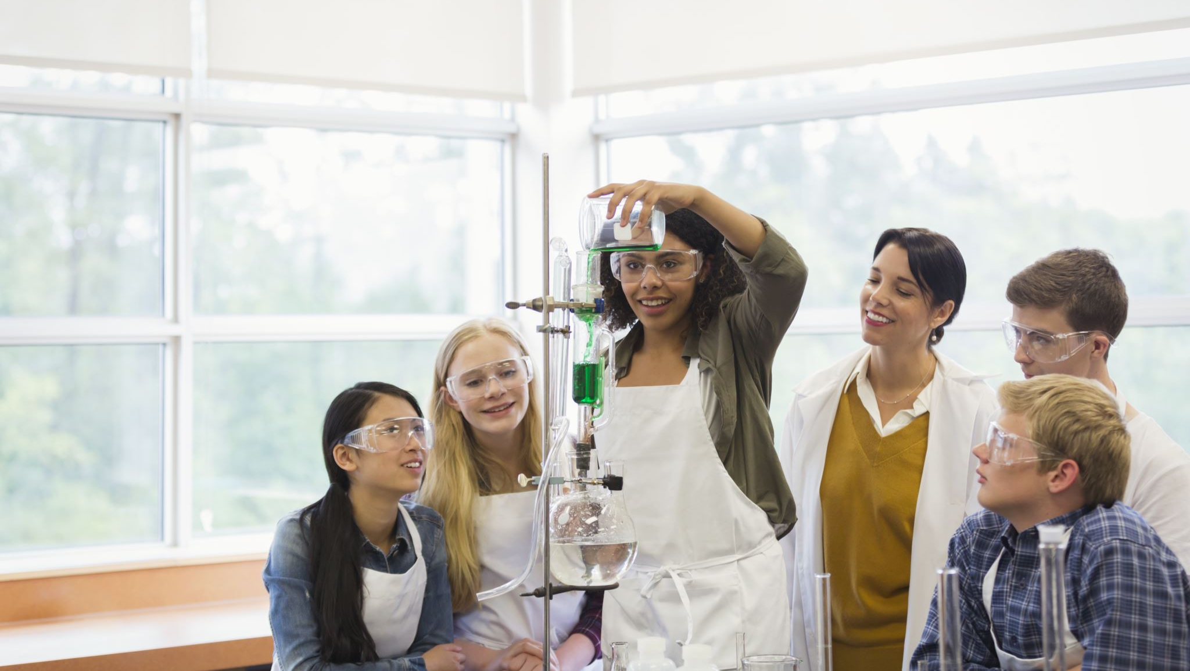
Exercise time
02-ARDs_and_Displays/02-demog_ard_exercise.R
02-ARDs_and_Displays/03-demog_table_exercise.R
Notes:
Go through each set in the process flow. Also open specs

